Slide 1
Chapter 11
Moderation and Mediation

Slide 2
Moderation
The combined effect of two variables on another is known conceptually as moderation, and in statistical terms as an interaction effect.
Interaction: Occurs when the effect of one independent variable (IV) on a dependent variable (DV) changes depending on the level of another independent variable
Independent factors have no interaction

Slide 3
Interaction Between Factors (1)
 | On Paper | On Screen
Fixed time | M = 20 | M = 20 | M Fixed Time = 20
Self-regulated time | M = 20 | M = 12 | M Self-Regulated = 16
 | M Paper = 20 | M Screen = 16
Notes:
What conclusions can we draw looking at the overall means?

Slide 4
Interaction Between Factors (2)
 | On Paper | On Screen
Fixed time | M = 20 | M = 20 | M Fixed Time = 20
Self-regulated time | M = 20 | M = 12 | M Self-Regulated = 16
 | M Paper = 20 | M Screen = 16
Notes:
What conclusions can we draw looking at the overall means?

Slide 5
Example
Do violent video games make people antisocial?
Participants
  442 youths
Outcome
  Aggression,
  Callous unemotional traits (CaUnTs)
  Number of hours spent playing video games per week

Slide 6
Conceptual Moderation Model (1 of 2)
If callous-unemotional traits were a moderator, then we’re saying that the strength or direction of the relationship between game playing and aggression is affected by callous-unemotional traits.

Slide 7
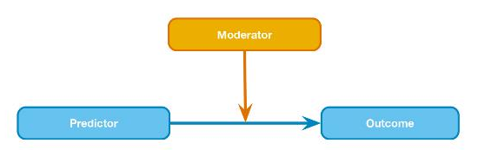
Conceptual Moderation Model (2 of 2)

Slide 8
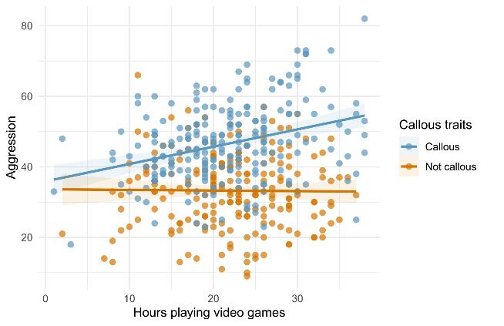
A categorical moderator (callous traits)

Slide 9
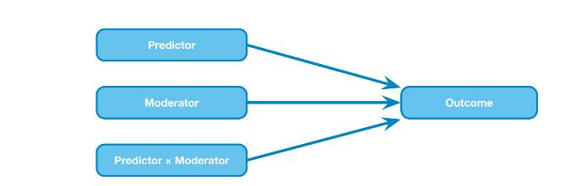
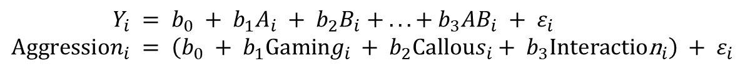
The Statistical Moderation Model
Figure 11.5 Diagram of the statistical moderation model
$$Y_{i} = b_{0} + b_{1}A_{i} + b_{2}B_{i} + ... + b_{3}AB_{i} + ε_{i} \\ Aggression_{i} = \left(b_{0} + b_{1}Gaming_{i} + b_{2}Callous_{i}+ b_{3}\text{Interactio}{\text{n}}_{i}\right) + ε_{i}$$

Slide 10
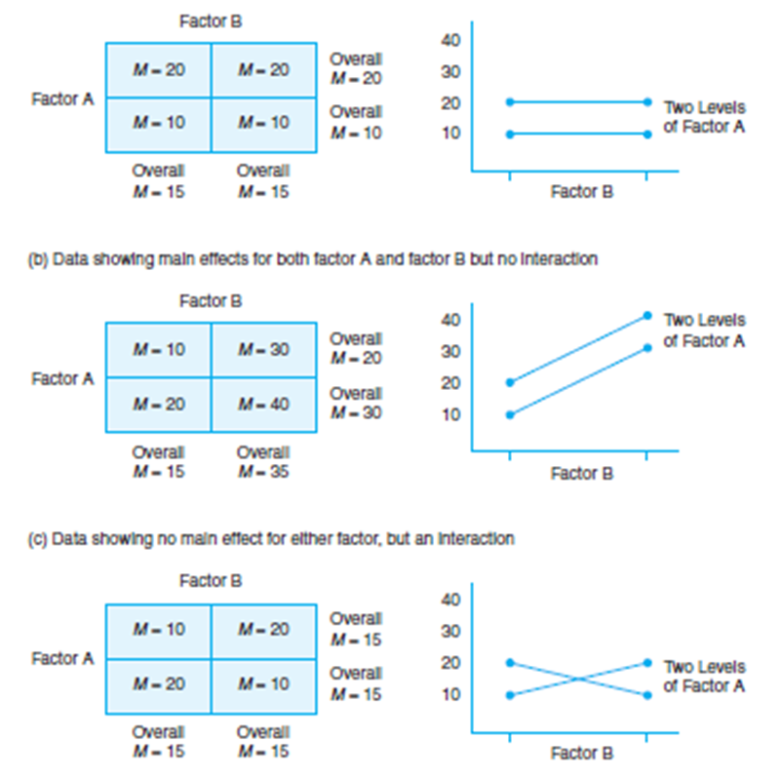
Interactions
Main effect Factor A
Not B
Main effect for A & B
No main effect
Interaction A&B

Slide 11
Centering Variables
The interaction term makes the bs for the main predictors uninterpretable in many situations
For this reason, it is common to transform the predictors using grand mean centering.
Centering refers to the process of transforming a variable into deviations around a fixed point
  Z-scores

Slide 12
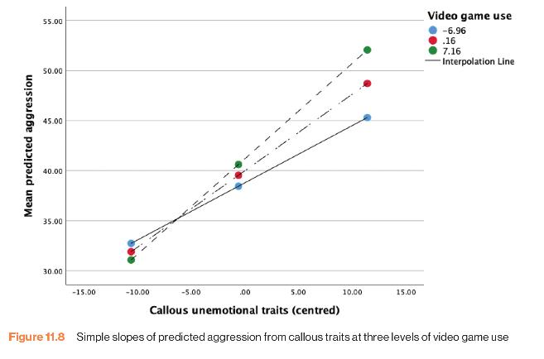
Simple slopes of predicted aggression from callous traits at three levels of video game use

Slide 13


Reporting Moderation Analysis
Table 11.1 Linear model of predictors of aggression.
 |  | SE | t | p
Constant (intercept) | 39.97 [39.03, 40.90] | 0.475 | 84.25 | p < 0.001
Callous traits (centred) | 0.76 [0.67, 0.85] | 0.047 | 16.30 | p < 0.001
Gaming (centred) | 0.17 [0.02, 0.32] | 0.076 | 2.23 | p = 0.027
Callous traits × Gaming | 0.027 [0.01, 0.04] | 0.007 | 3.66 | p = 0.003
$$\overset{̑}{b}$$
$$\overset{̑}{b}$$
Note. R² = 0.38

Slide 14
Mediation
Refers to a situation when the relationship between a predictor variable and outcome variable can be explained by their relationship to a third variable (the mediator).

Slide 15
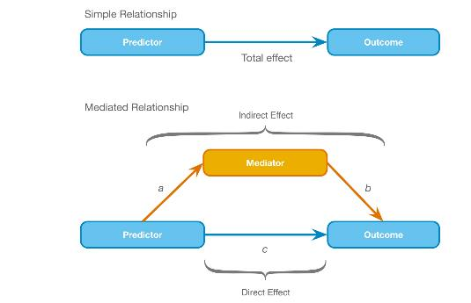
The Statistical Model

Slide 16
Baron & Kenny (1986) (1 of 2)
Mediation is tested through three regression models:
  Predicting the outcome from the predictor variable.
  Predicting the mediator from the predictor variable.
  Predicting the outcome from both the predictor variable and the mediator.

Slide 17
Baron & Kenny (1986) (2 of 2)
Four conditions of mediation:
  The predictor must significantly predict the outcome variable.
  The predictor must significantly predict the mediator.
  The mediator must significantly predict the outcome variable.
  The predictor variable must predict the outcome variable less strongly in model 3 than in model 1.

Slide 18
Limitations of Baron & Kenny’s (1986) Approach
How much of a reduction in the relationship between the predictor and outcome is necessary to infer mediation?
  People tend to look for a change in significance, which can lead to the ‘all or nothing’ thinking that p-values encourage.

Slide 19
Sobel Test (Sobel, 1982)
An alternative is to estimate the indirect effect and its significance using the Sobel test (Sobel, 1982).
If the Sobel test is significant, there is significant mediation.
Significance tests depend upon sample size.

Slide 20
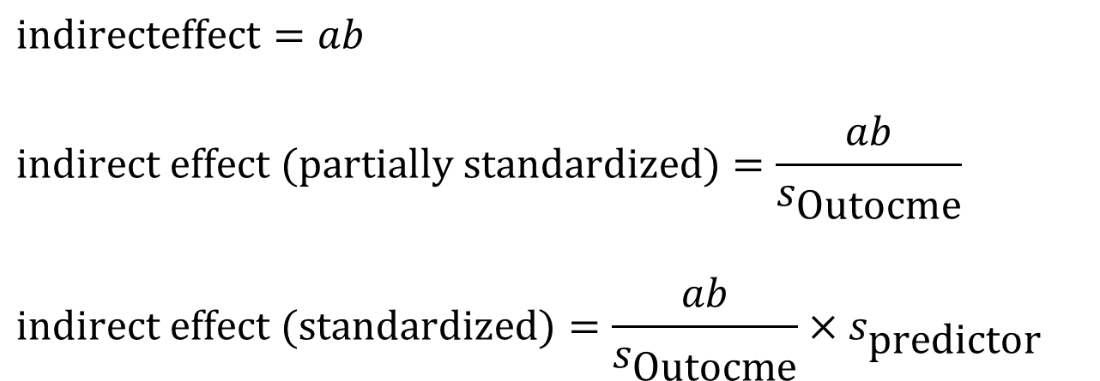
Effect Sizes of Mediation (1 of 2)
$$\text{indirecteffect}=ab$$
$$\text{indirect} \text{effect} (\text{partially} \text{standardized})=\frac{ab}{s_{\text{Outocme}}}$$
$$\text{indirect} \text{effect} (\text{standardized})=\frac{ab}{s_{\text{Outocme}}}×s_{\text{predictor}}$$

Slide 21
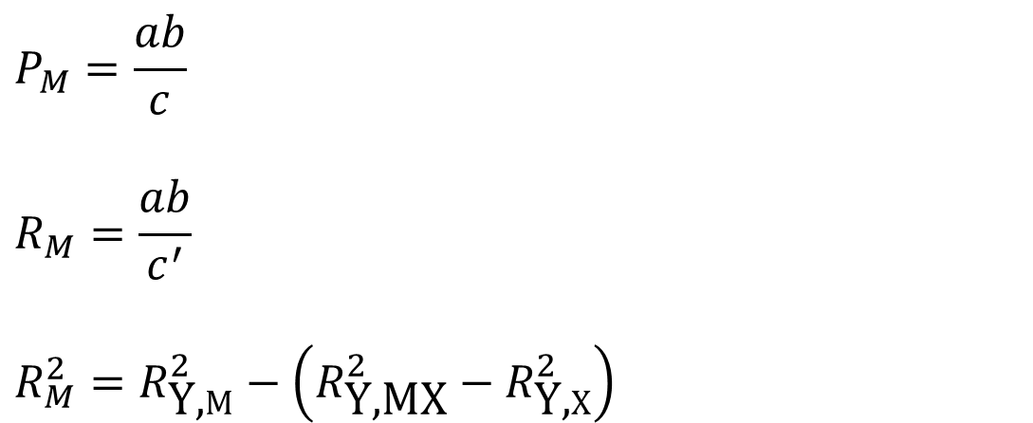
Effect Sizes of Mediation (2 of 2)
$$P_{M}=\frac{ab}{c}$$
$$R_{M}=\frac{ab}{c^{′}}$$
$$R_{M}^{2}=R_{\text{Y}\text{,}M}^{2}−\left(R_{\text{Y}\text{,}\text{MX}}^{2}−R_{\text{Y}\text{,}X}^{2}\right)$$

Slide 22
Categorical Predictors in Regression
Often, you will have categorical predictors that have more than two categories.
These groups cannot be distinguished using a single variable coded with zeros and ones. Therefore, we use what’s called dummy variables.

Slide 23
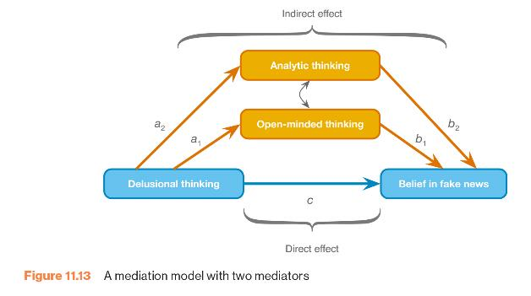
A Mediation Model with Two Mediators

